Slide 1
Taking the sting out of pain management
Sarah Merritt, MD
MACS Consultant
Lifestream Health Center
Bowie, MD
ABMS board certified in Anesthesiology, Pain Medicine, Addictions Medicine

Slide 2

Maryland Addiction Consultation Service (MACS)
Provides support to prescribers and their practices in addressing the needs of their patients with substance use disorders and chronic pain management.
All Services are FREE
Phone consultation for clinical questions
Education and training opportunities related to substance use disorders and chronic pain management
Assistance with addiction and behavioral health resources and referrals
Technical assistance to practices implementing or expanding office-based addiction treatment services
MACS TeleECHO Clinics: collaborative medical education through didactic presentations and case-based learning
1-855-337-MACS (6227) • www.marylandMACS.org

Slide 3
Objectives and outline
Understand the fundamental principles of acute pain management:
Define the essentials of chronic pain management
Recognize the unique challenges in managing pain in patients with Opioid Use Disorder (OUD) and those on Medication for Opioid Use Disorder (MOUD)
Describe emerging trends and innovations in pain management

Slide 4
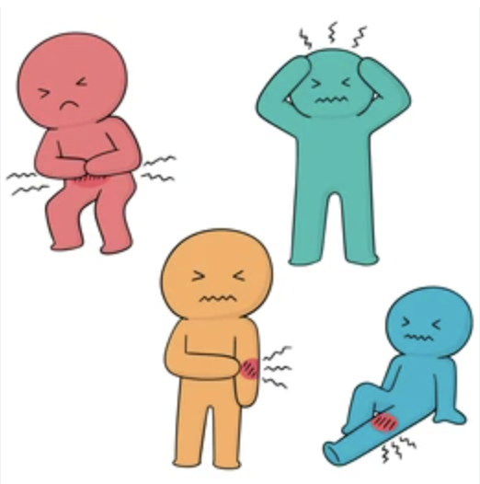
Acute pain and its physiological basis
Pain warns us of potential danger to tissue harm or to the presence of injury
Due to stimulation of nociceptors or pain sensors
Examples:
  joint replacement,
  acute injuries
  wounds

Slide 5
Common assessment tools for acute pain
Numerical Rating Scale (NRS)
Visual Analog Scale (VAS)
Defense and Veterans Pain Rating Scale (DVPRS)
Adult Non-Verbal Pain Scale (NVPS)
Pain Assessment in Advanced Dementia Scale (PAINAD)
Behavioral Pain Scale (BPS)
Critical-Care Observation Tool (CPOT)
---→ these facilitate early intervention which is associated with better pain outcomes

Slide 6
Acute pain and its physiological basis
Treatments:
  Pharmacologic
    Nsaids
    Opioids
    Muscle relaxers
  Non-pharmacologic
    Heat/Ice
    TENS/Stimulation
    PT
    Stretching
    Trigger point work

Slide 7
What about Chronic Pain?
Chronic pain is longstanding pain that persists beyond the usual recovery period or occurs along with a chronic health condition, such as arthritis.
Usually 12 weeks or 90 days

Slide 8
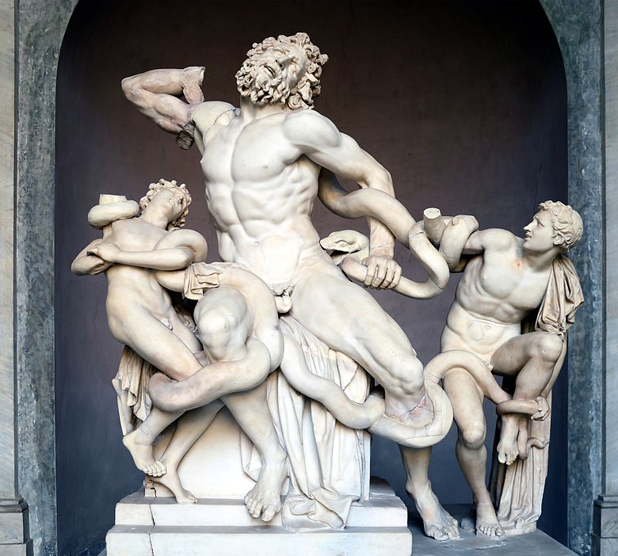
International Association for the Study of Pain:
Definition of pain
An unpleasant sensory and emotional experience associated with, or resembling that associated with, actual or potential tissue damage
Pain is always a personal experience that is influenced to varying degrees by biological, psychological, and social factors.
Pain and nociception are different phenomena. Pain cannot be inferred solely from activity in sensory neurons.
Through their life experiences, individuals learn the concept of pain.
A person’s report of an experience as pain should be respected.
Although pain usually serves an adaptive role, it may have adverse effects on function and social and psychological well-being.
Verbal description is only one of several behaviors to express pain; inability to communicate does not negate the possibility that a human or a nonhuman animal experiences pain.
Laocoön and His Sons on display in the Vatican. “The prototypical icon of human agony”

Slide 9
“Pain is whatever the experiencing person says it is, existing whenever the experiencing person says it does” - Margo McCaffery RN, MS, FAAN, early Hospice movement pioneer
Notes:
We agree you have pain, we can disagree with what to do about it.

Slide 10
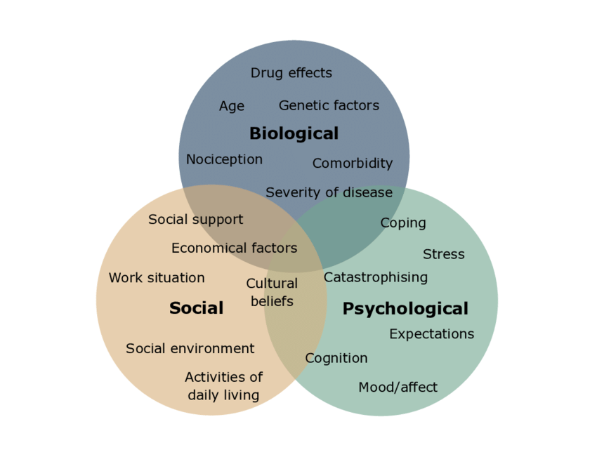
Biopsychosocial Model of Chronic Pain

Slide 11
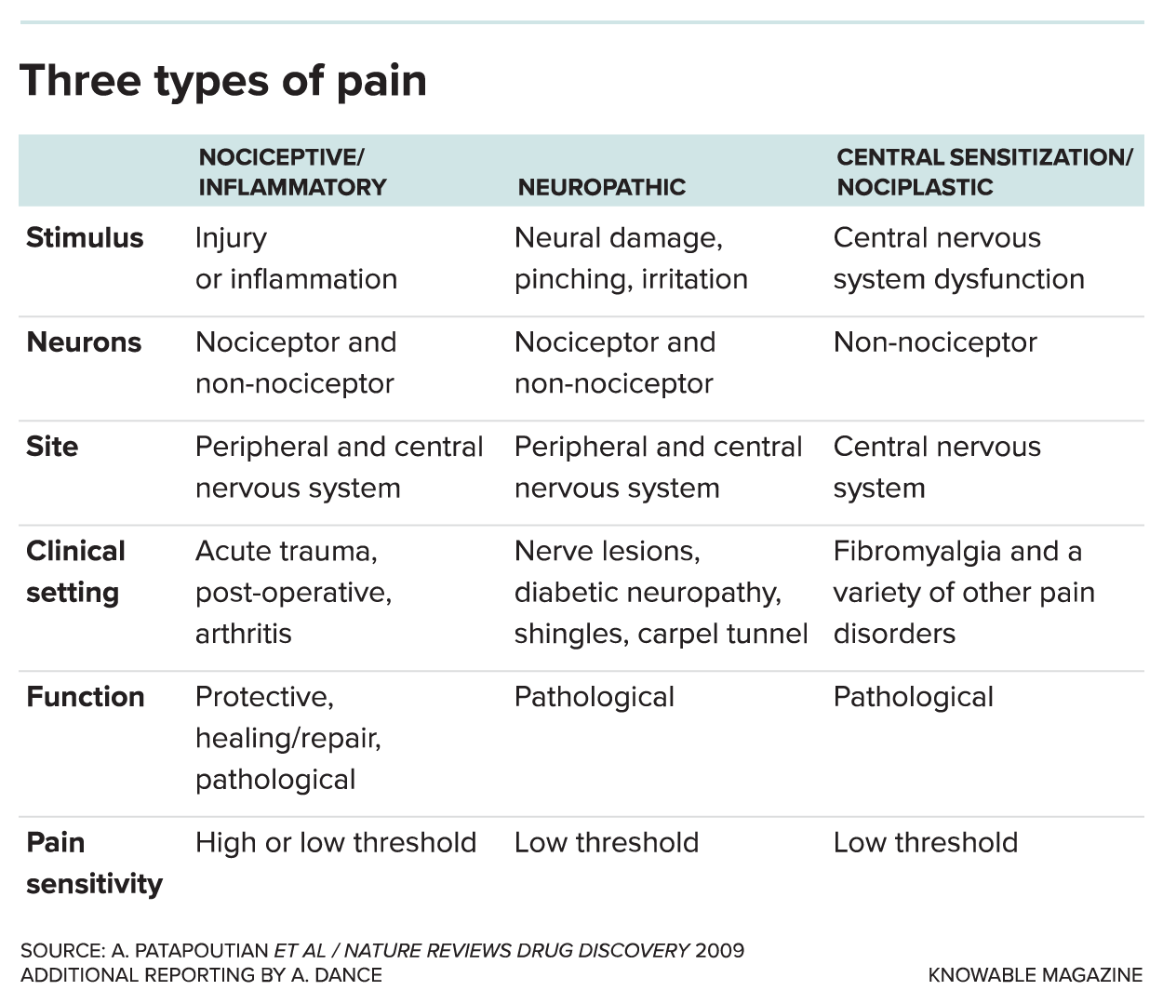

Slide 12
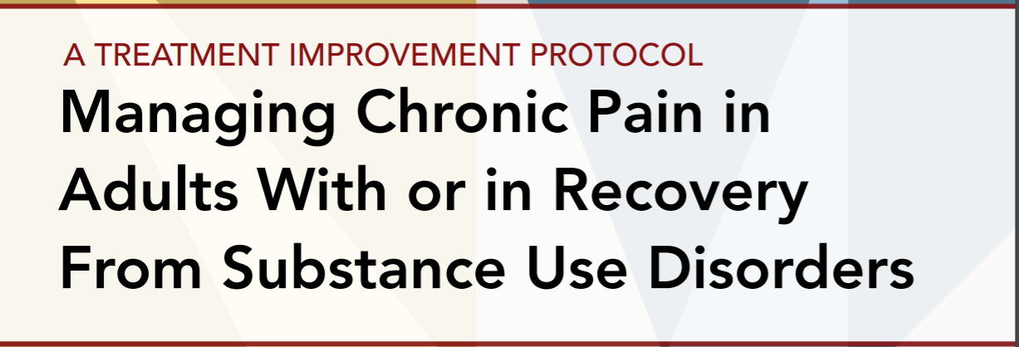
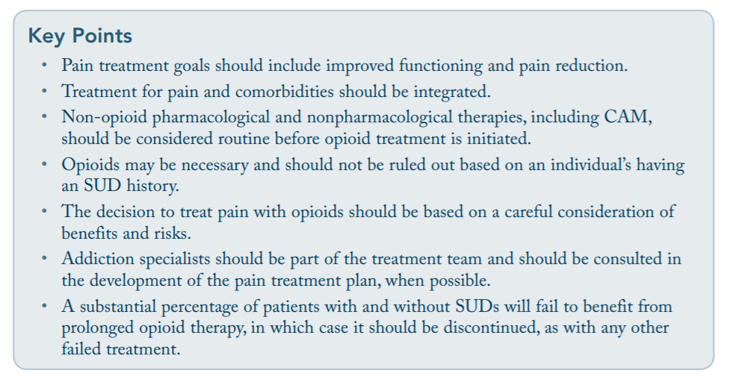
Notes:
-This is from TIP 54, 2011, department of health and human services, center for substance abuse treatments
-CAM = complementary alternative methods

Slide 13
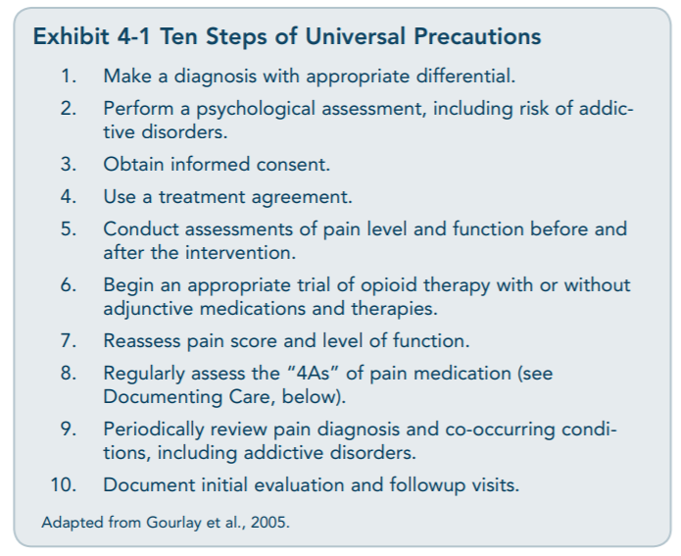
Notes:
-management is similar for those without SUD. Except the risk is higher.
-Anti-convulsants indicated, but low efficacy
-Anti-depressants: low efficacy
-Tylenol and NSAID’s: small effect size, better for short intervals
-SMR: only for acute
-oral steroids: no use
-opioids: very very selective

Slide 14
Quiz:
Do patients with OUD or substance use history sometimes benefit from prescription opioids for pain? Yes/No
Will they need an average amount or above average amount? Average/above average
Are opioids the only medication that works for pain? Yes/No
Do patients with OUD have chronic pain at the same rate as general population or higher? Same/Higher

Slide 15
Questions?
Type Questions into the chat or Raise hand
Additional questions:
1-855-337-MACS (6227)
MACS@som.umaryland.edu
MACS Services
Stay up to date: MACS Monthly Newsletter
www.marylandmacs.org/Contact-Us/
Prescribers: Sign up for MACS via phone or
https://bit.ly/2KE5nCT

